Slide 1
Working collaboratively with Git
James Whale, Data Engineer

Slide 2
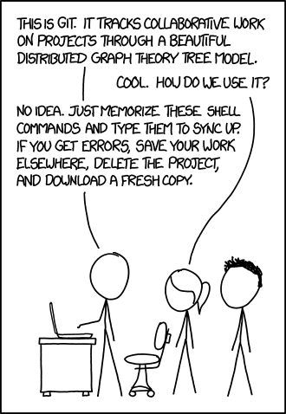
What is Git?

Slide 3
Using Git collaboratively
Git allow a team of developers to work collaboratively on the same project at the same time
Gitflow model
Pull Requests

Slide 4
Gitflow model
Master branch
Develop branch
Feature branches
Release branches
Hotfix branches

Slide 5
Master branch
The master branch is the main branch of a project
The master branch is a permanent branch
It should represent the production state of the repository
Access to the master branch should be tightly controlled
Whenever changes are merged into the master this branch, this is a new production release

Slide 6
Develop branch
The develop branch is a permanent branch
It’s state should represent the latest delivered development ready for the next release
Sometime called the integration branch
When the develop branch is in a stable state and is ready for a new release, the develop branch will be merged into the master branch

Slide 7
Feature branches
A feature branch is a short lived branch used to develop a new feature
Feature branches will usually branch from the develop branch
Feature branches should always be merged back into the develop branch
Feature branches should only exist for the duration of the development of the new feature

Slide 8
Release branches
A release branch is used in preparation of a new production release
Release branches will usually branch from the develop branch
Release branches should always be merged back into the develop or master branches
Release branches allow for minor bugfixes and testing before a release
By doing this work on a release branch it frees up the develop branch for the development towards the next big release

Slide 9
Hotfix branches
A hotfix branch is similar to a release branch, except they are for unplanned changes such as a critical bug found in production code
hotfix branches will usually branch from the master branch
hotfix branches should always be merged back into the develop and master branches
This allows for the fix to be applied to the master branch without disrupting new work on the develop branch

Slide 10
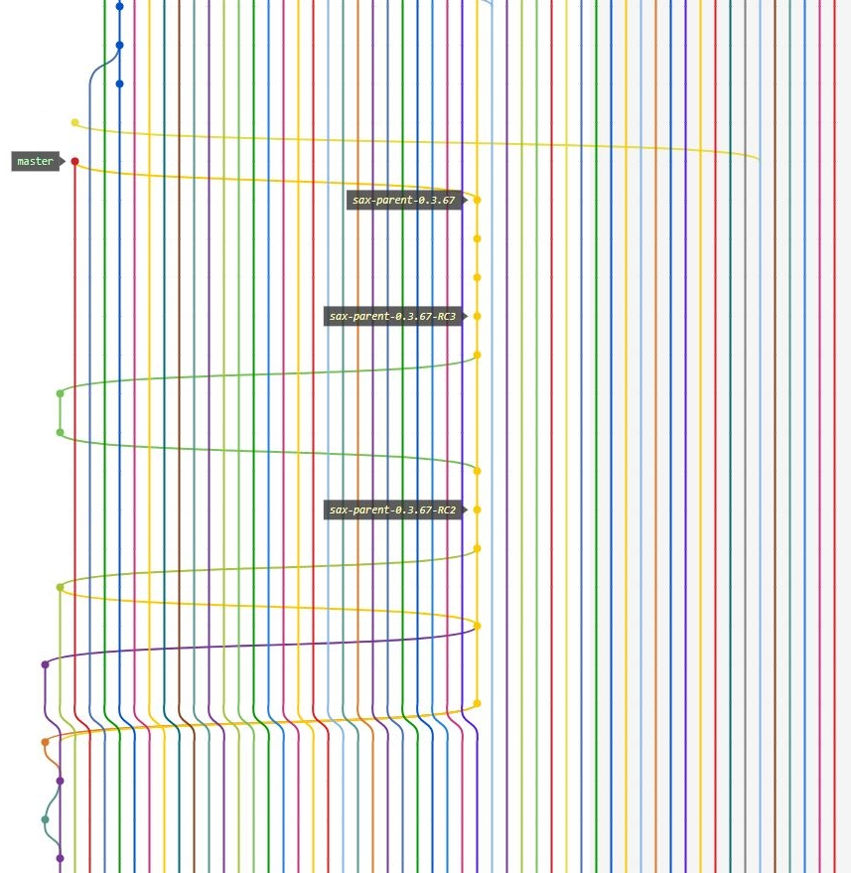

Slide 11
Pull Requests
Pull Requests are a mechanism for allowing a developer to notify team member that they have completed a feature
Once a developer has completed a feature they will create a pull request between their feature branch and the develop branch
This allows the team to discuss, review and provide feedback on the proposed new feature before it is committed
Depending on the outcome of the review and discussion on the pull requests the pull request may be merged into the develop branch or the original developer will make additional changes to the feature to and update their pull request

Slide 12
Questions?

Slide 13
Workshop
Go to https://github.com/jameswhale/git-introduction/
Work through meetup-git-workshop.md
Ask myself or Alison questions about it or anything else

